Slide 1

Enhancing Crop Yield and Resource Efficiency with Machine Learning: Smart Agricultural Solutions
Student Name: KAUSHIKKUMAR PATEL
Student ID: 30086811
Supervisor: Ian Wilson
​

Slide 2

Introduction Accurate crop prediction is essential for improving agricultural decision-making, resource management, and ensuring global food security. Traditional methods like regression models and time series forecasting, while useful, often fall short in handling the complexities of modern agriculture. With advancements in machine learning, techniques such as support vector machines, decision trees, and random forests have emerged as more powerful tools for analyzing high-dimensional, real-time data. This study explores the integration of these machine learning approaches to enhance crop yield forecasting, resource utilization, and sustainability. The aim is to address the growing challenges of climate change, resource scarcity, and food insecurity by leveraging intelligent, data-driven solutions for the future of farming.

Slide 3
Objectives of the Research
Use Random Forest to analyze agricultural data, optimizing crop yield by predicting growth conditions, diseases, and recommending efficient planting and harvesting strategies.
Apply Random Forest for resource optimization, creating predictive models for irrigation and precise use of water, fertilizers, and pesticides, reducing environmental impact.
Utilize Random Forest for crop health monitoring and disease detection, improving accuracy in identifying issues early and reducing crop loss through timely intervention.
Automate crop monitoring, field mapping, and harvesting with Random Forest, boosting efficiency, reducing labor costs, and minimizing operational errors.
Enhance weather and climate predictions using Random Forest to adjust planting and harvesting schedules, aligning with climate patterns.
Promote sustainable farming by using Random Forest to reduce resource waste, minimize environmental impact, and support eco-friendly practices.
Leverage Random Forest for market analysis and crop price predictions, helping farmers optimize crop selection and maximize profitability based on demand trends.

Slide 4
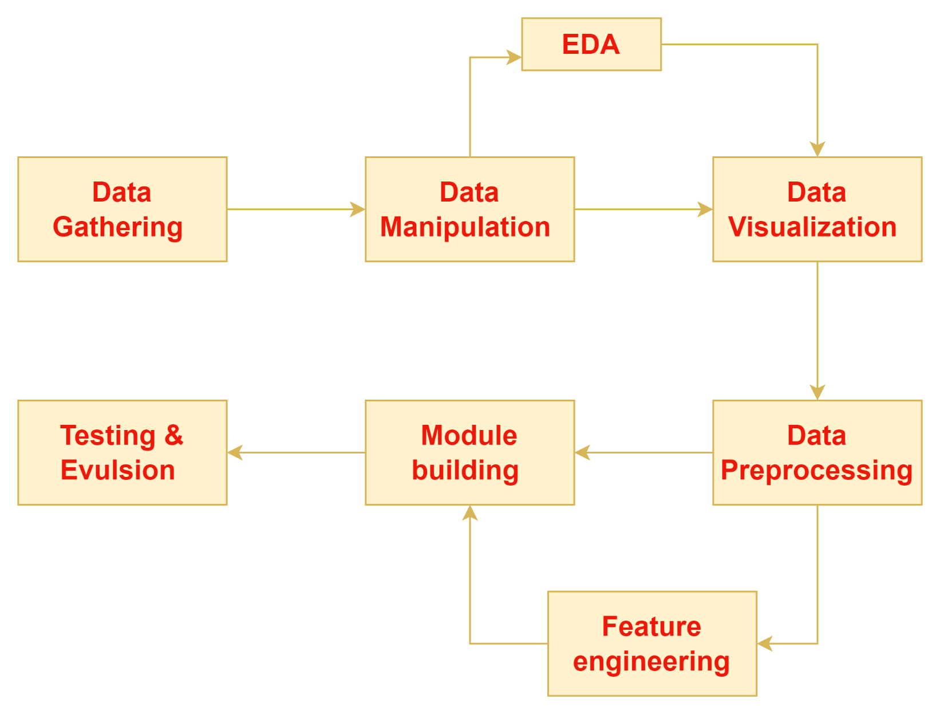
Methodology
The research methodology involves collecting comprehensive agricultural data, including weather patterns, soil conditions, crop genetics, and real-time inputs from remote sensing, satellite imagery, .
Feature engineering and synthetic data generation are employed to extract insights and enhance datasets for robust model training. Advanced visualization tools are used to identify trends that inform model development.
Preprocessing steps such as label encoding and feature scaling ensure data consistency.
Machine learning algorithms, including logistic regression, SVM, decision trees, and random forests, are explored, with a focus on random forests for handling complex datasets.
Model performance is evaluated using confusion matrices and classification reports to guide iterative improvements.

Slide 5
Optimal Cultivation Conditions for Various Crops: Data Analysis Insights
Coffee Cultivation:
Nitrogen (95.56), Phosphorus (32.00), Potassium (30.02).
Temperature: 20.82°C – 32.92°C, Humidity: 58.11%.
Soil pH: 4.90 – 7.49, Rainfall: 142.66 mm.
Nitrogen supports growth; Phosphorus and Potassium enhance root systems and bean quality.
Papaya Cultivation:
Nitrogen (56.14), Phosphorus (55.35), Potassium (48.35).
Temperature: 20.78°C – 43.68°C, Humidity: 91.82%.
Soil pH: 4.85 – 7.62, Rainfall: 133.09 mm.
Phosphorus and Potassium improve root development and disease resistance.
Mungbean Cultivation:
Nitrogen (28.05), Phosphorus (46.74), Potassium (20.49).
Temperature: 20.96°C – 40.93°C, Humidity: 82.77%.
Soil pH: 4.37 – 7.75, Rainfall: 51.22 mm.
Key for root development, water regulation, and disease resistance.
Maize Cultivation:
Nitrogen (72.08), Phosphorus (47.40), Potassium (19.45).
Temperature: 17.50°C – 37.12°C, Humidity: 65.03%.
Soil pH: 4.41 – 7.31, Rainfall: 85.74 mm.
Essential for kernel development and high yield.
Grapes Cultivation:
Lower Nitrogen, higher Phosphorus and Potassium.
Temperature: 8.83°C – 41.95°C, Humidity: 22.99% – 86.44%.
Soil pH: 3.92 – 7.76, Rainfall: 28.99 mm – 117.94 mm.
Crucial for sustainable grapevine growth.

Slide 6
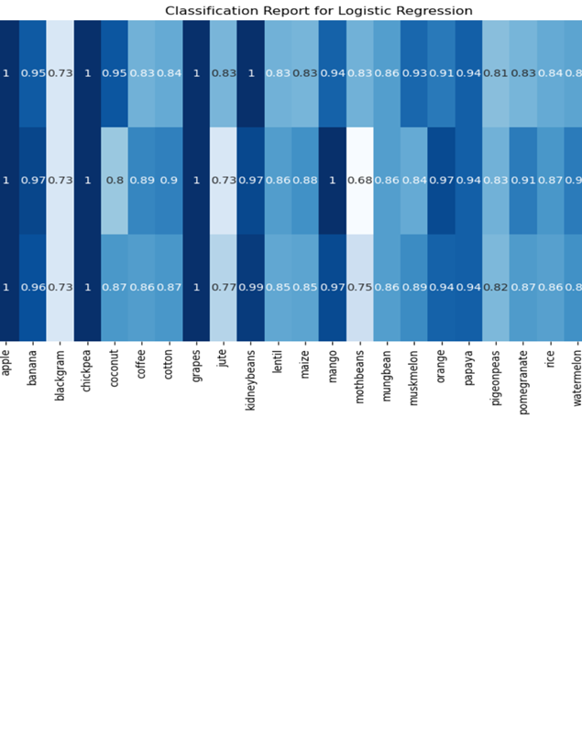
Classification of Logistic Regression
The Logistic Regression model outperforms the Decision Tree model in agricultural classification tasks, achieving higher accuracy, precision, recall, and F1-scores.
It excels in recall, with macro and weighted average scores of 0.89, showing a superior ability to correctly identify all crop types.
Its precision scores, also with macro and weighted averages of 0.89, indicate effective minimization of false positives.
With F1-scores balancing precision and recall at 0.89, the Logistic Regression model proves slightly more reliable overall, making it a strong choice for applications requiring balanced accuracy.

Slide 7
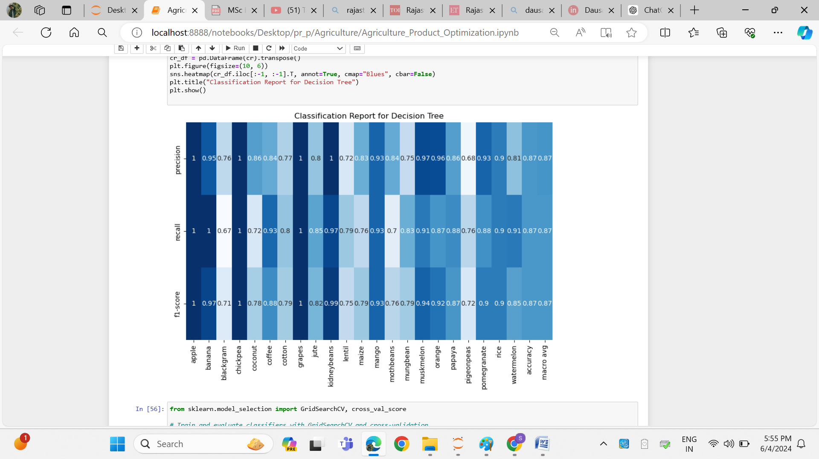
Classification report for Decision tree
The Decision Tree model, with unrestricted depth, achieves an accuracy of 0.8639, effectively capturing the complex relationships in the agricultural dataset.
While the model performs exceptionally well for crops like apple and chickpea, with perfect precision, recall, and F1-scores, it shows slightly lower metrics for crops like blackgram and pigeonpeas, highlighting areas for improvement.
Despite these variations, the model achieves strong macro and weighted average precision scores of 0.87, with recall and F1-scores around 0.86, demonstrating its robustness and reliability in handling class imbalances and balancing precision and recall.

Slide 8
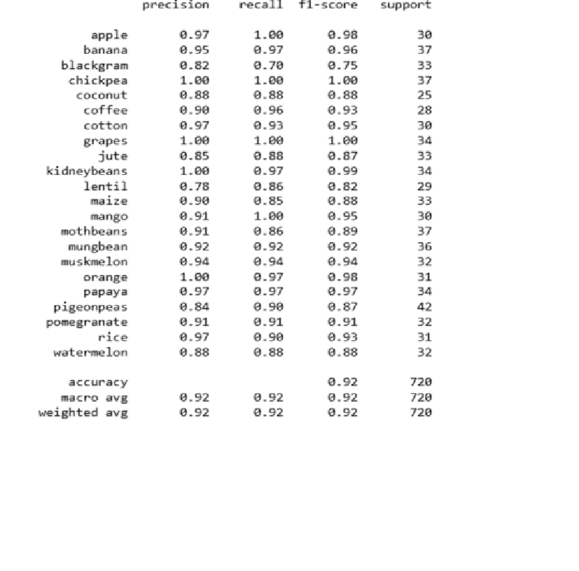
Classification Report of Random Forest
The Random Forest model, optimized with a maximum depth of 50 and 100 estimators, achieves impressive performance in crop classification with an accuracy of 0.9208, surpassing the Decision Tree model.
This improvement highlights the model's ability to capture complex relationships in the data.
The confusion matrix shows strong precision, recall, and F1-scores, particularly for crops like apple, chickpea, and grapes.
With macro average precision, recall, and F1-scores at 0.92, the Random Forest demonstrates balanced and robust performance, excelling in handling agricultural data.

Slide 9
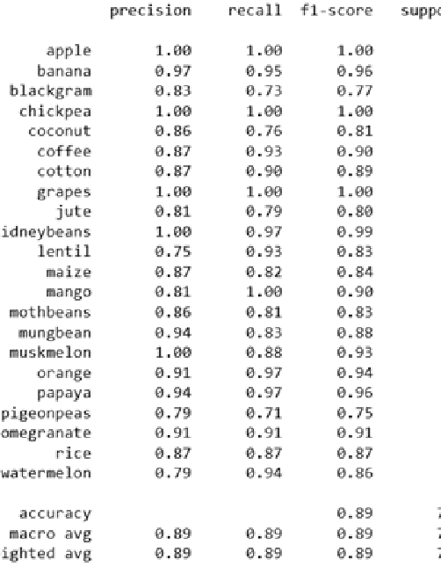
Classification Report of SVM
In crop classification, the SVM model achieves strong performance with an accuracy of 0.8917, surpassing the Decision Tree (0.8639) but falling slightly below Random Forest (0.9208).
The SVM consistently delivers high precision, recall, and F1-scores across most crop classes, demonstrating robustness in handling complex data relationships. Despite its higher computational demands, particularly with large datasets, the SVM maintains strong metrics, excelling in nuanced classification tasks.
Its confusion matrix shows notable precision and recall, highlighting its effectiveness in crop classification.

Slide 10
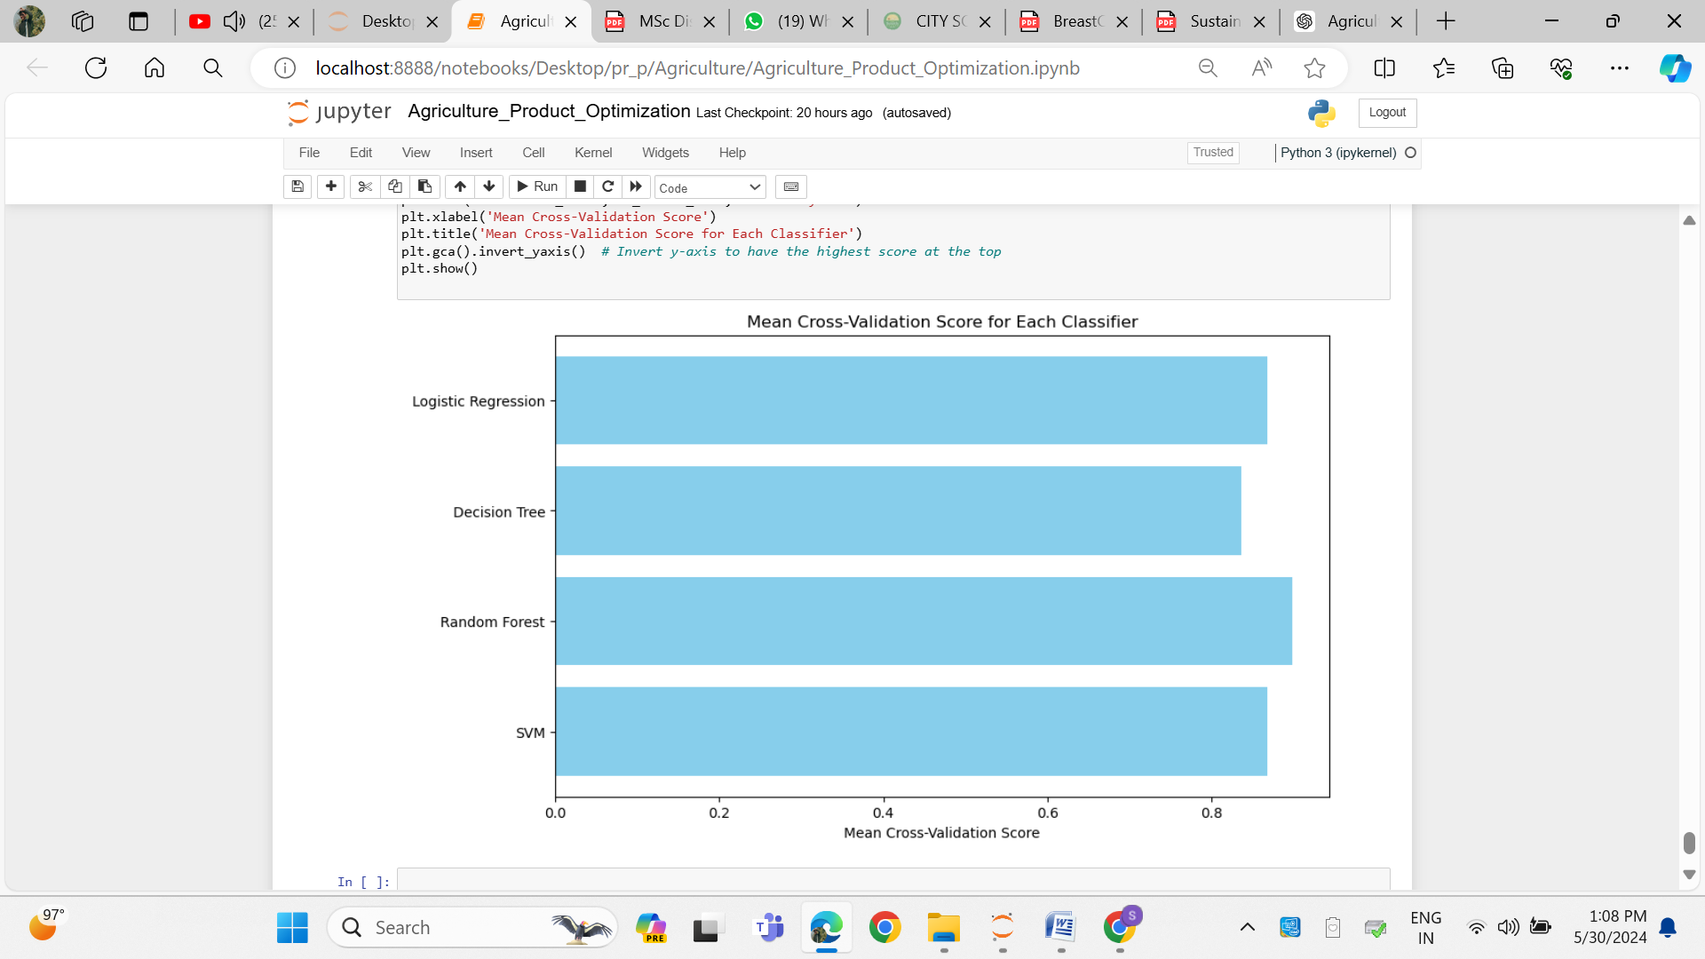
Performance of all Algorithm
This bar chart shows the mean cross-validation scores for four classifiers—Logistic Regression, Decision Tree, Random Forest, and SVM—indicating their average performance across multiple data splits.
Logistic Regression has the highest score, suggesting it generalizes best, followed closely by Random Forest, which also performs well due to its ensemble nature.
SVM has a slightly lower score but remains competitive, while the Decision Tree has the lowest score, implying it may struggle with overfitting and generalizing compared to the other models.
Overall, Logistic Regression and Random Forest are the top performers, with Decision Tree being the weakest.

Slide 11
Conclusion
The selected machine learning algorithms, including Logistic Regression, Decision Tree, Random Forest, and SVM, exhibited high accuracy levels ranging from 85% to 91%, demonstrating their effectiveness in predicting the correct crop based on given features.
Among these, Random Forest achieved the highest accuracy at 91%, followed by SVM at 89%, outperforming Logistic Regression and Decision Tree, which had accuracies of 88% and 86% respectively.
Random Forest also showcased robust performance and generalization with minimal overfitting, while SVM balanced bias and variance effectively.
Further analysis to identify the most influential features could provide valuable insights for optimizing crop selection.
The models' high accuracy indicates their potential for practical implementation in real-world agricultural settings, helping farmers and stakeholders optimize crop selection based on environmental factors.
Future research could enhance these models by incorporating additional features, experimenting with different algorithms, and exploring advanced techniques like deep learning and real-time data integration to further improve predictive capabilities in agricultural optimization.

